Slide 1

To Programming with
Welcome

Slide 2
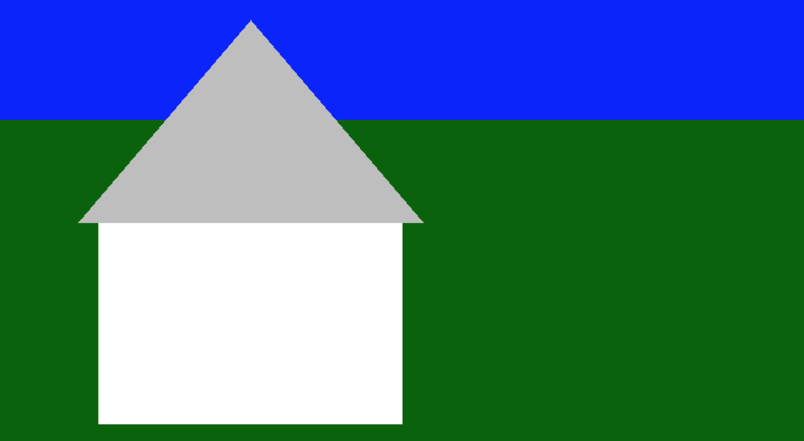
Let’s Draw this House
Start: double-click on the file “house.py”.
The code will open in the editor.

Slide 3
House: Write some code
Here, the blue code is what you already see in the editor. Add the code that is inside the bubble below. Start by pressing the “Tab” key to indent.
import pygame
pygame.init()
screen = pygame.display.set_mode((800,600))
while True:
event = pygame.event.poll()
if event.type == pygame.QUIT:
pygame.quit()
# Draw the Shapes
screen.fill(pygame.Color("dark green"))
pygame.draw.rect(screen, pygame.Color("blue"), (0,0,799,199))
pygame.draw.rect(screen, pygame.Color("white"), (100,300,300,200))
pygame.draw.polygon(screen, pygame.Color("gray"), [(80,300), (420,300), (250, 100)])
pygame.display.flip()
Type the four lines below into the program. First press Tab key to indent from the left and line up with “# Draw the Shapes”. Press “Return” key after each line to start the next line.
Tab

Slide 4
Run the House Program
Click the “Save” button at the top of the editor.
Always save your program, otherwise it will not run your changes.
Double-click “Play house.py” to see your house!
If you do not see the house, check your code for mistakes.
Close the house window when you’re done looking at it.

Slide 5
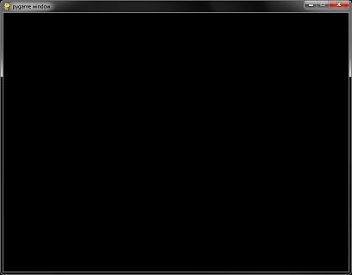
The window is 800 pixels wide and 600 pixels high
screen = pygame.display.set_mode((800, 600))
0
x
799
0
(0, 0)
Pixel means “picture element”.
Counting starts at zero.
A point is two numbers, (x, y).
X is distance from the left.
Y is distance from the top.
The top-left corner is (0,0)
The bottom-right is (799,599)
The center is (400,300)
y
(400, 300)
(799, 599)
599
Notes:
Screen is a grid of tiny dots called “pixels”
X & Y axis
Top-left corner is 0,0

Slide 6
How to Draw a Rectangle
pygame.draw.rect(screen, pygame.Color("white"), (100,50,300,200))
50
100
200
300
The four numbers are the top, left, width, and height of the rectangle. You can use different numbers to change the location and size.

Slide 7
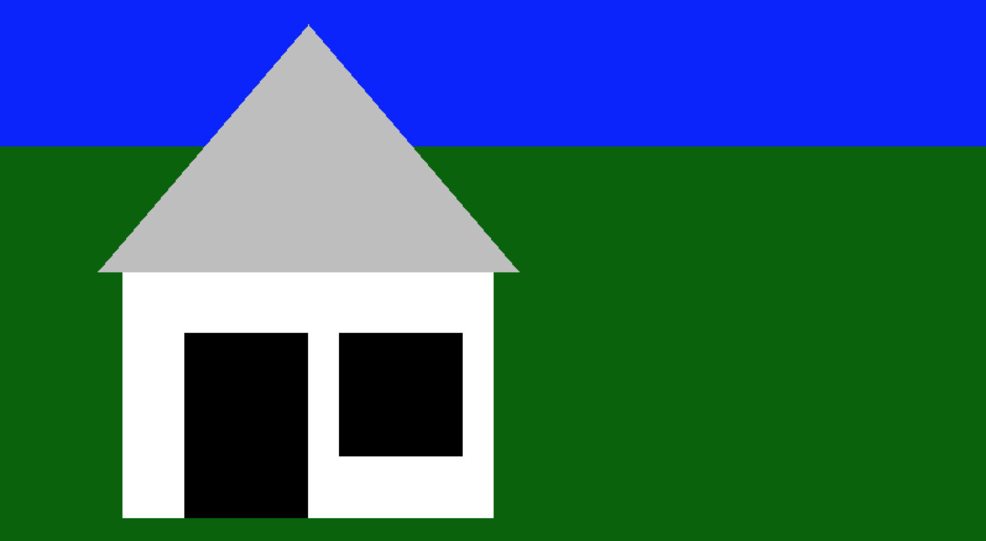
Can you add a door and window?

Slide 8
Each square is 25 pixels. Dark lines are 100.

Slide 9
How to Draw a Circle
pygame.draw.circle(screen, pygame.Color("white"), (320,200), 50)
The two numbers between () are the center point. The first is distance from the left. The second is distance from the top. The third number is the size of the circle.

Slide 10
Let’s Bounce a Ball Around
We’re going to make a ball bounce around the screen!
Load the file “bounce.py”.

Slide 11
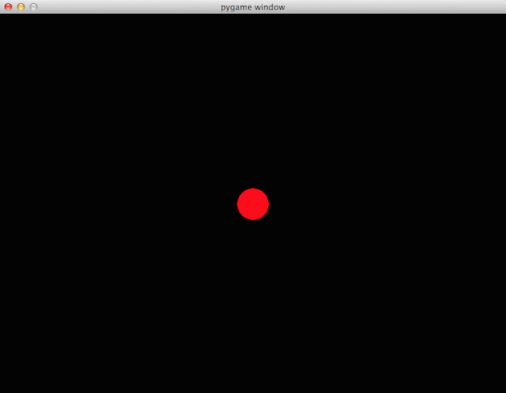
1) Draw a ball in the center
Look in the program for the comment “Start ball in the center”. Then add the new code in black:
# Start ball in the center
ball = screen_rect.center
You must indent four spaces, so the “pygame.draw.circle” code begins at the same position as the “# Draw the ball” comment:
# Draw the ball
pygame.draw.circle(screen, pygame.Color("red"), ball, 25)

Slide 12
2) Move the ball!
Add the new code in black:
# Start ball in the center
ball = screen_rect.center
ball_dx = 5
ball_dy = 5
# Move the ball
ball = (ball[0]+ball_dx, ball[1]+ball_dy)
Now the ball is moving diagonally down and to the right.

Slide 13
3) Bounce the ball!
Add the new code in black. Remember to indent four spaces from the left margin.
# Bounce the Ball
if ball_dx > 0 and ball[0] > screen_rect.right:
ball_dx = -ball_dx
elif ball_dx < 0 and ball[0] < screen_rect.left:
ball_dx = -ball_dx
if ball_dy > 0 and ball[1] > screen_rect.bottom:
ball_dy = -ball_dy
elif ball_dy < 0 and ball[1] < screen_rect.left:
Now the red ball will bounce around the screen!

Slide 14
4) Change It
Ball color: Change the color “red” to “blue”, “yellow”, or your favorite color. Remember to put the color name in quotation marks.
Ball speed: Change the numbers after “ball_dx = 5” and “ball_dy = 5”. Try “ball_dx = 3” or “ball_dy = 8”. What happens?

Slide 15
Here’s the final bounce.py program.
import pygame
pygame.init()
clock = pygame.time.Clock()
screen = pygame.display.set_mode((800,600))
screen_rect = screen.get_rect()
# Start ball in the center
ball = screen_rect.center
ball_dx = 5
ball_dy = 5
running = True
while running:
clock.tick(60)
event = pygame.event.poll()
if event.type == pygame.QUIT:
running = False
# Bounce the Ball
if ball_dx > 0 and ball[0] > screen_rect.right:
ball_dx = -ball_dx
elif ball_dx < 0 and ball[0] < screen_rect.left:
ball_dx = -ball_dx
if ball_dy > 0 and ball[1] > screen_rect.bottom:
ball_dy = -ball_dy
elif ball_dy < 0 and ball[1] < screen_rect.left:
ball_dy = -ball_dy
# Move the ball
ball = (ball[0]+ball_dx, ball[1]+ball_dy)
screen.fill(pygame.Color("black"))
# Draw the ball
pygame.draw.circle(screen, pygame.Color("red"), ball, 25)
pygame.display.flip()
pygame.quit()

Slide 16
Let’s Change a Game
Double-click “IntroToPyGame-master”
Right-click “blockout.py”
Select “Open”

Slide 17
Change the Ball and Paddle
Change some of these colors and numbers and then play the game:
##### Constants ################################
block_color = "blue"
paddle_color = "green"
ball_color = "red"
ball_size = 25
ball_speed = 2
paddle_size = 60
paddle_speed = 4
Type new color names inside the quotation marks.
Change the numbers after the equals signs.

Slide 18
Aim the Ball with the Paddle
Find the section “Bounce ball off the paddle” and add the line in black to the program:
if paddle.colliderect(ball):
ball_dy = -ball_dy
ball_dx = (ball.centerx - paddle.centerx) / 12
Change the 12 to another number and see what happens.
Remember to indent four spaces here.
ball_dx = -2
ball_dx = 0
ball_dx = +2

Slide 19
Keeping Score
Make each block worth 10 points and show the player’s score on the screen. This requires adding multiple lines of code in different parts of the game program.
In “Game Pieces” section, add a score counter:
score = 0
In “Ball hits a block” section after “if hit > -1:”, increase the score by ten points:
score += 10
In “Draw the Screen” section after “screen.fill((0,0,0))”,
draw the score in top-left corner:
draw_text(str(score), game_board.topleft)

